Slide 1
TRACKING SOFTWARE THAT KEEPS RECORDS OF REPAIR WORK AND OTHER INFORMATION ABOUT A VEHICLE
GROUP 7:
BENJAMIN HODGEKINS, JACK O’CONNER, JUSTIN POLCHIES

Slide 2
PROJECT DESCRIPTION
Our app will keep track of information about repairs, maintenance, fuel efficiency, and compile all this information into an easily digestible format for budget purposes.
Main Format: Mobile Application.
Use Cases
Login
Profile
Enter information
Track different Vehicles

Slide 3
EXECUTIVE SUMMARY
Our app will keep track of information about car repairs, maintenance, fuel efficiency, and compile all this information into an easily digestible format for budgeting purposes. This is to help users manage their finances surrounding cars. There are many different aspects of a car that you need to keep track of, and our app will provide a one stop shop to do so.

Slide 4
PROBLEM STATEMENT
People have a hard time organizing and keeping track of their financial information about their vehicles. We will build an application which allows them to easily archive this information.

Slide 5
PROJECT TIMELINE
First Iteration – Use case: User Login
Due March 8th
Completed: Created UI for login screen
Three functional buttons(new user, Login, exit), Two text fields for user name and passwords.
Both user name and password have a pattern requirement set.
Not Completed:
Min and Max length for password.

Slide 6
PROJECT TIMELINE CONT
Iteration 2 – Use Case: Profile, Main Screen(menu)
Due April 5th
Milestone:
Create UI for a individual to set up a profiles.
User Profile
Car Profile
Create Main screen
This will give the user selection to choose from: entering a new car or adding a repair to current car profile.

Slide 7
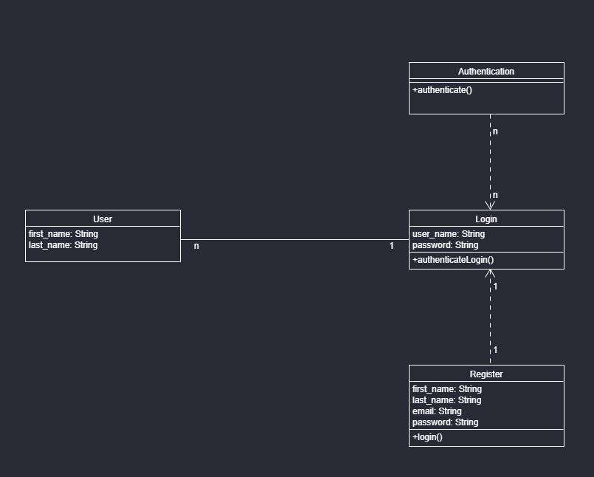
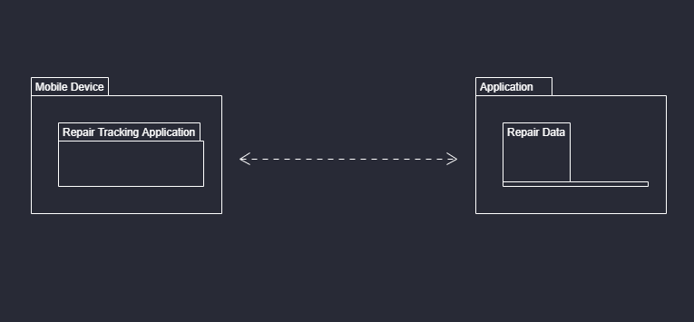
UML Diagrams

Slide 8
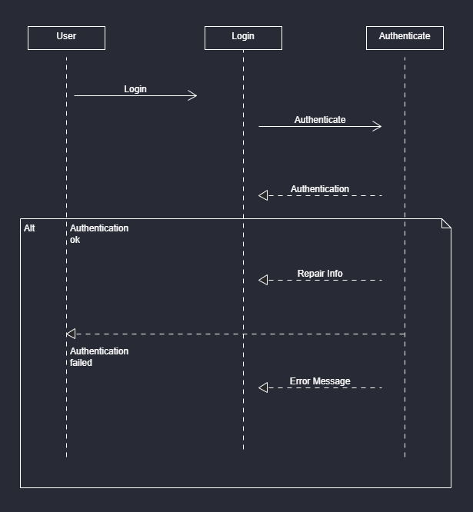
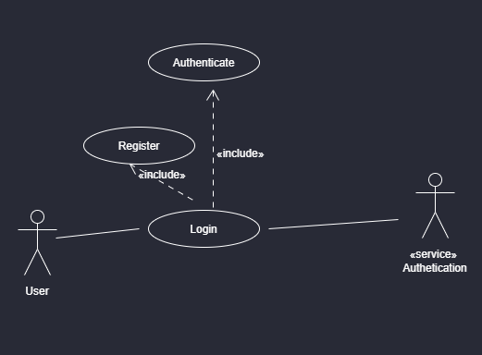
UML Diagrams

Slide 9
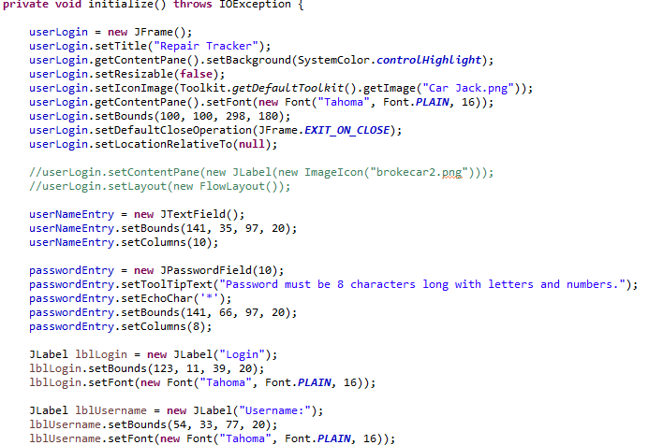
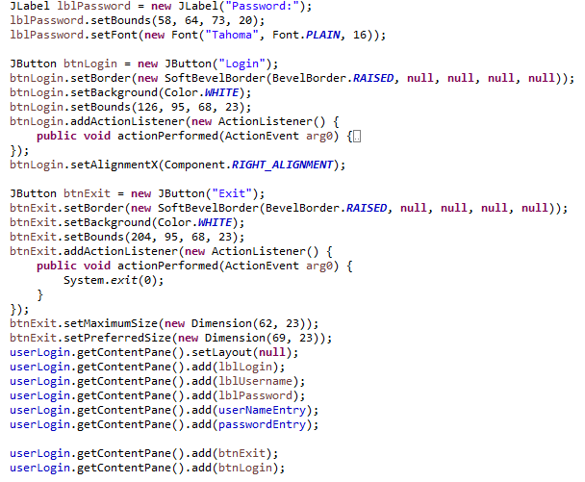
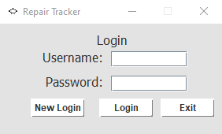
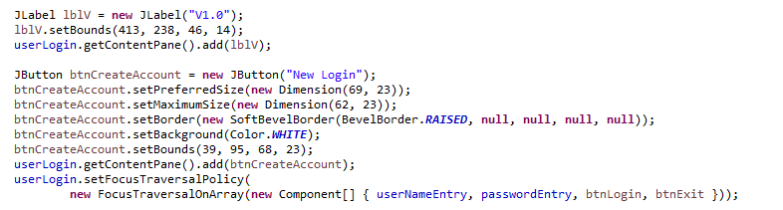
ITERATION 1- LOGIN SCREEN WITH CODE

Slide 10
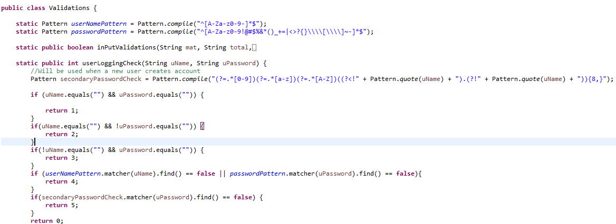
ITERATION 1 – MORE CODE

Slide 11
AREAS OF POSSIBLE IMPROVEMENTS
Improvements can and will be made it the input validation.
UI layout

